Slide 1

ENSEMBLE METHODS

Slide 2


WHAT ARE ENSEMBLE METHODS?
Ensemble methods base themselves on the idea that the average opinion of several weak predictors will yield a strong predictor.
A Group of predictors is called an Ensemble, thus the Ensemble learning method
Data Squad | Ensemble Learning

Slide 3
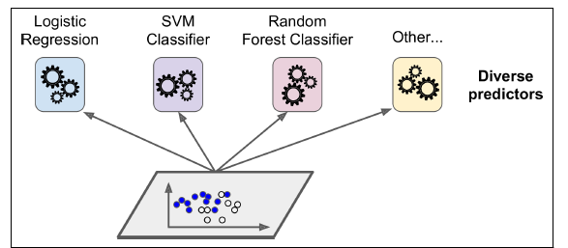
VOTING CLASSIFIERS
Train individually the algorithms that we have seen so far and then take a vote of the answers!
Process of voting classifiers:
- train individually each algorithm
- save all the generated models in a function
Data Squad | Ensemble Learning

Slide 4
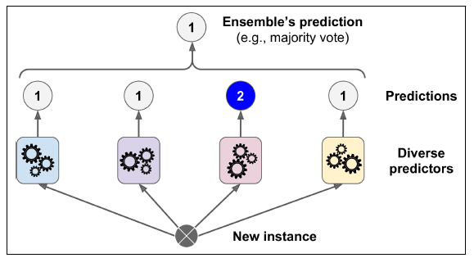
VOTING CLASSIFIERS
Train individually the algorithms that we have seen so far and then take a vote of the answers!
Once you receive a new instance (data point) you can then pass it through all the algorithms and perform a majority vote of the answer (classification problem)
Data Squad | Ensemble Learning

Slide 5

STACKING
Why can't we take this one step further and have our ensemble of weak classifiers and then have one final algorithm that "learns" the best way to perform the final decision?
This is an alternative to using a naive majority vote or average
Let's train a model to perform this aggregation
Data Squad | Ensemble Learning

Slide 6
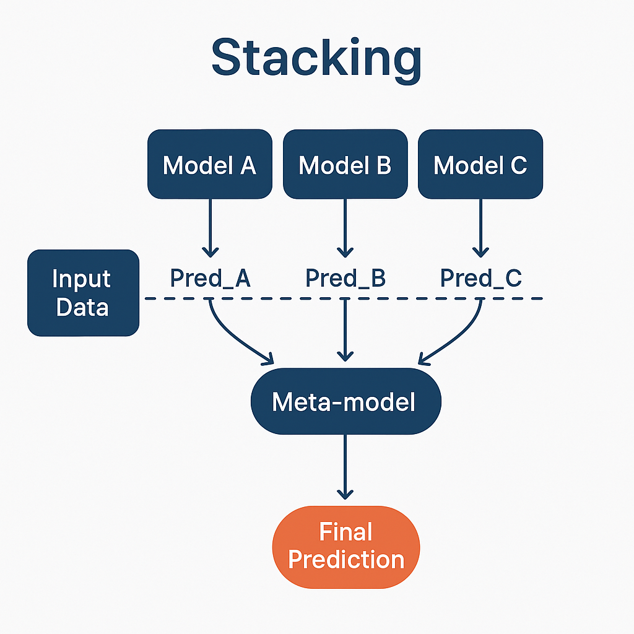
STACKING
Why can't we take this one step further and have our ensemble of weak classifiers and then have one final algorithm that "learns" the best way to perform the final decision?
This is an alternative to using a naive majority vote or average
Let's train a model to perform this aggregation
Data Squad | Ensemble Learning

Slide 7
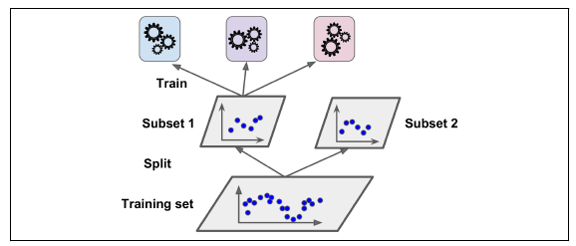
STACKING
In practice this is done in two steps:
From your training dataset, leave out a subset to then be used to train the blending algorithm.
Perform your usual training
Data Squad | Ensemble Learning

Slide 8
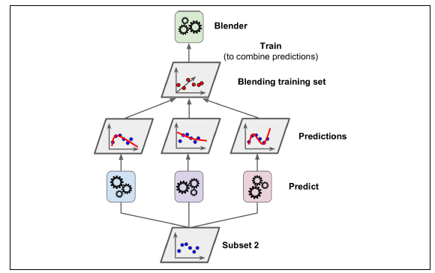
STACKING
In practice this is done in two steps:
Use the second subset that the trained weak predictors have never seen before to make them make predictions.
Finally with these predictions a final blending algorithm will be trained to find the best way to combine the predictions
Data Squad | Ensemble Learning

Slide 9

VOTING CLASSIFIERS
when can this go wrong?
Well, this is a great voting system if all algorithms are truly independent of each other and will not tend to overfit in the same way or have the same weaknesses.
If they are not independent, you are simply giving more weight to inaccurate predictions.
hence the importance of having diverse classifiers
Data Squad | Ensemble Learning

Slide 10
BAGGING AND PASTING
So how can we make sure that we create independent classifiers?
One way is to always use the same algorithm but then train it on a different random sample of the training dataset.
Bagging - When random sample is taken with replacement
Pasting - When random sample is taken without replacement
Data Squad | Ensemble Learning

Slide 11
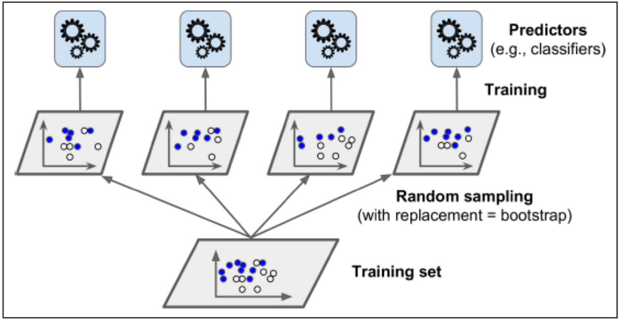
Both are ensemble methods where you train multiple models (usually of the same type) on different subsets of the training data, and then aggregate their predictions (e.g., majority vote or averaging).
The only real difference is in how the subsets are selected.
BAGGING AND PASTING
Data Squad | Ensemble Learning

Slide 12
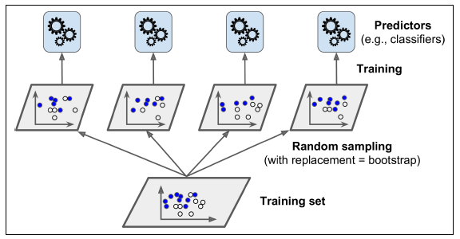
BAGGING AND PASTING
BAGGING: With replacement (“Bootstrapping”): Each model sees a random subset of the training data, and the same data point can appear more than once.
Pasting:
Without replacement: Each model gets a random subset of the training data, but each data point appears only once across the subset.
Data Squad | Ensemble Learning

Slide 13
BAGGING AND PASTING
can be used for both regression and classification tasks.
Random forest. constructs multiple decision trees on bootstrapped subsets of the data and aggregates their predictions for final output, reducing overfitting and variance.
Data Squad | Ensemble Learning

Slide 14
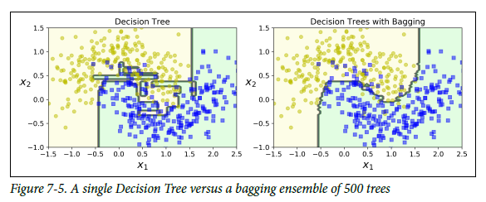
BAGGING AND PASTING - EXAMPLE
Data Squad | Ensemble Learning

Slide 15




RANDOM PATCHES METHOD
The previous methods randomized the training data used. What else could we randomize?
Data Squad | Ensemble Learning

Slide 16
RANDOM PATCHES METHOD
The previous methods randomized the training data used. What else could we randomize?
The FEATURES
Data Squad | Ensemble Learning

Slide 17

RANDOM PATCHES METHOD
The previous methods randomized the training data used. What else could we randomize?
The FEATURES
By repeating the algorithm training process randomizing both the training data subset but also the features chosen to perform the training is called the Random Patches Method
Data Squad | Ensemble Learning

Slide 18
RANDOM PATCHES METHOD
The previous methods randomized the training data used. What else could we randomize?
The FEATURES
By repeating the algorithm training process randomizing both the training data subset but also the features chosen to perform the training is called the Random Patches Method
Becomes more powerful when we have a very high dimensional problem (many features!). This is the case in image processing for example (each pixel is a feature)
Data Squad | Ensemble Learning

Slide 19
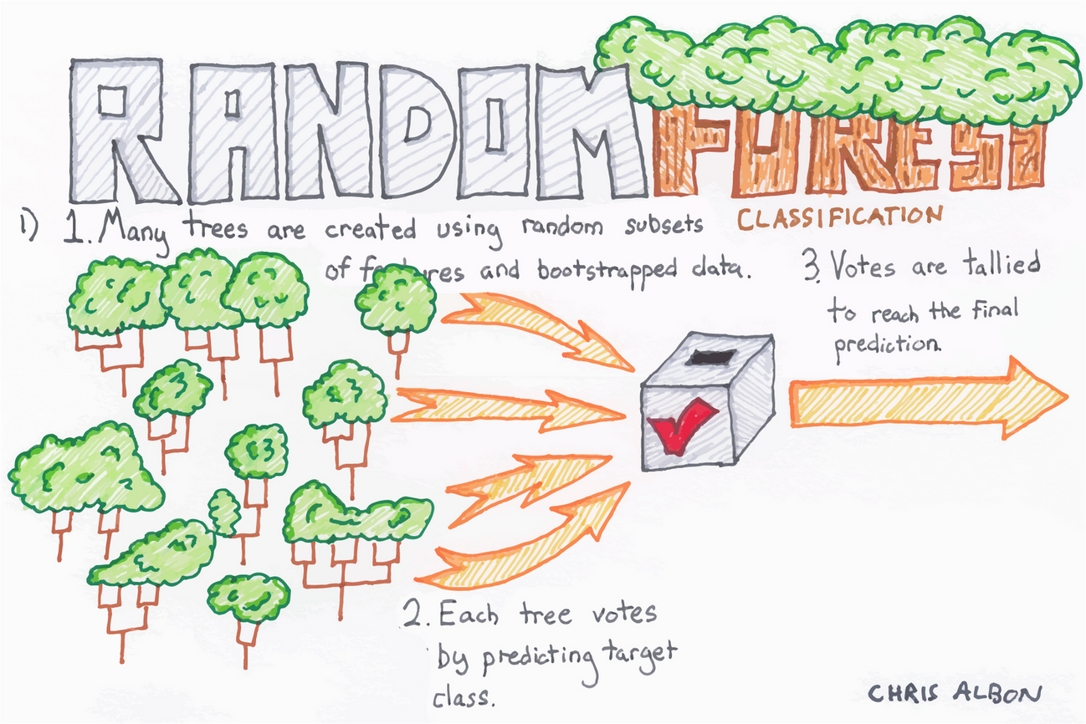
RANDOM FORESTS
Working of Random Forest Algorithm
Create Many Decision Trees: The algorithm makes many decision trees each using a random part of the data. So every tree is a bit different.
Pick Random Features: When building each tree it doesn’t look at all the features (columns) at once. It picks a few at random to decide how to split the data. This helps the trees stay different from each other.
Each Tree Makes a Prediction: Every tree gives its own answer or prediction based on what it learned from its part of the data.
Combine the Predictions:
For classification we choose a category as the final answer is the one that most trees agree on i.e majority voting.
For regression we predict a number as the final answer is the average of all the trees predictions.
Data Squad | Ensemble Learning

Slide 20
RANDOM FORESTS
RandomForestClassifier: for classification documentation
RandomForestRegressor: for regression documentation
Data Squad | Ensemble Learning

Slide 21
Hyperparameter | What It Controls | Common Values | Effect of Higher/Lower Values
n_estimators | Number of trees in the forest | 100–500 | Higher: More stable but slower Lower: Faster but less accurate
max_depth | Maximum depth of each tree | 5–30 or None | Higher: Overfitting risk Lower: Underfitting risk
max_features | Features considered at each split | 'sqrt', 'log2', None | Lower: More diverse trees Higher: More similar trees
min_samples_split | Min samples to split a node | 2–10 | Higher: Simpler trees Lower: More complex trees
min_samples_leaf | Min samples at leaf node | 1–5 | Higher: Smoother model Lower: Sensitive to noise
random_state | Seed for reproducibility | 0, 42, etc. | Doesn't affect performance; for reproducibility

Slide 22

JUPYTER (Random Forest)
Data Squad | Ensemble Learning

Slide 23

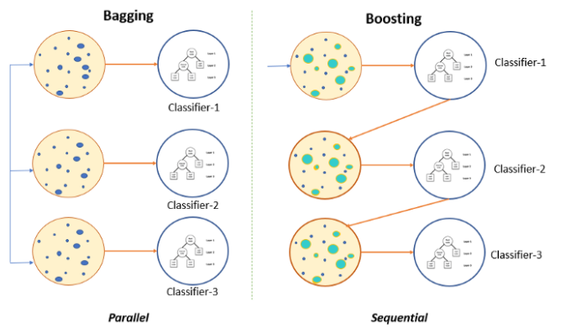
BOOSTING
Data Squad | Ensemble Learning

Slide 24
BOOSTING
Any Ensemble method that can combine weak learners into a strong learner
Models are trained one after another. Each new model focuses on fixing the errors made by the previous ones. The final prediction is a weighted combination of all models, which helps reduce bias and improve accuracy.
There are two common methods that are the most popular:
- AdaBoost (Adaptive Boosting)
- Gradient Boosting
Data Squad | Ensemble Learning

Slide 25
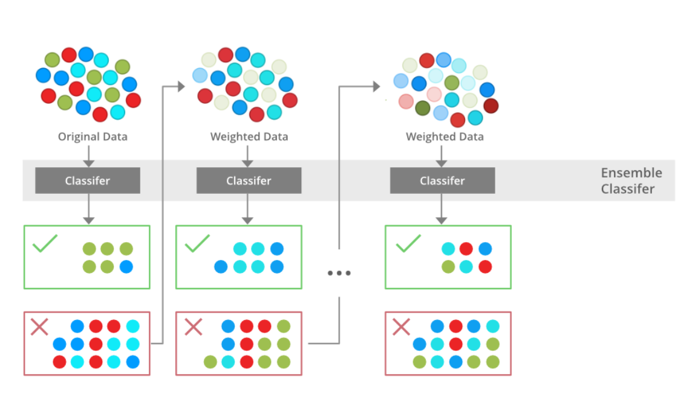
ADA BOOSTING
In adaboosting each new classifier looks at the previous and tries to see on which training instances did he seem to underfit
This results in a new prediction focusing on those cases.
It works by sequentially adding classifiers to correct the errors made by previous models giving more weight to the misclassified data points. AdaBosting Paper
Data Squad | Ensemble Learning

Slide 26
ADA BOOSTING: documentation
Parameter | Default | Description | Effect of Higher/Lower Values
n_estimators | 50 | Number of weak learners | Higher: better fit but slower & risk of overfitting Lower: faster but may underfit
learning_rate | 1.0 | Shrinks contribution of each model | Higher: faster learning, risk overfitting Lower: more stable, needs more estimators
estimator (or base_estimator) | Decision stump | Weak learner | Stronger models reduce bias but risk overfitting
algorithm | 'SAMME.R' | Use 'SAMME.R' for probabilities | 'SAMME.R' usually performs better using probabilities
Data Squad | Ensemble Learning

Slide 27
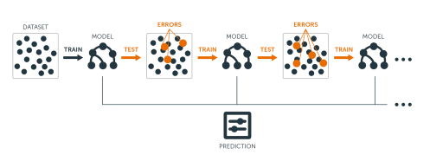
GRADIENT BOOSTING
Similarly to AdaBoost, Gradient Boosting works be sequentially adding predictors to an ensemble each correcting its predecessor.
The difference is that Gradient Boosting tries to fit the new predictor to the residual errors made by the previous predictor
Data Squad | Ensemble Learning

Slide 28
GRADIENT BOOSTING
what does this mean?If I have a training dataset X and a target variable y:
I am now going to see the mistakes made by my fit
Compute the array of those mistakes
and then try to create a model that based on the input features X, predicts the errors!!!
Data Squad | Ensemble Learning

Slide 29
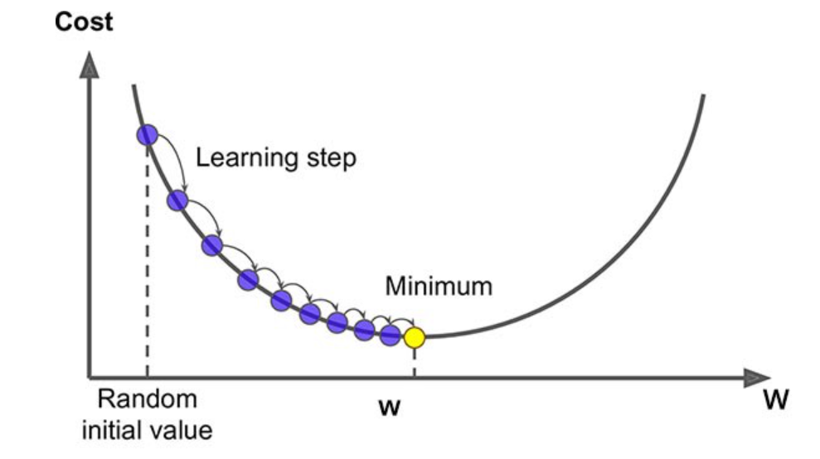
Gradient Boosting trains new models to minimize the loss function (e.g., MSE, cross-entropy) of the previous model using gradient descent
Gradient descent is an optimization algorithm used to minimize a function, often a loss function in machine learning.

Slide 30
Working of Gradient Boosting
1. Sequential Learning Process
The ensemble consists of multiple trees each trained to correct the errors of the previous one. In the first iteration Tree 1 is trained on the original data and the true labels.
It makes predictions which are used to compute the errors.
2. Residuals Calculation
In the second iteration Tree 2 is trained using the feature matrix and the errors from Tree 1 as labels. This means Tree 2 is trained to predict the errors of Tree 1. This process continues for all the trees in the ensemble. Each subsequent tree is trained to predict the errors of the previous tree.
3. Shrinkage
After each tree is trained its predictions are shrunk by multiplying them with the learning rate η which ranges from 0 to 1. This prevents overfitting by ensuring each tree has a smaller impact on the final model.
Once all trees are trained predictions are made by summing the contributions of all the trees.

Slide 31
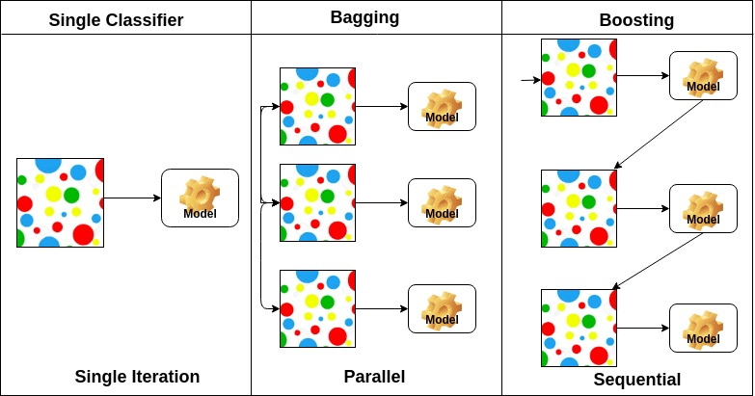
SUMMING UP
Data Squad | Ensemble Learning

Slide 32


ANY QUESTIONS ?

